Slide 1


(RentNinja)
RENT & HOUSING PLATFORM
team 2
Team Lead: Yongjing Wu
Security Lead: Jiacheng Ding
Design and Implementation Lead: Yueyang He
Requirement Lead: Xueqi Zhou
Configuration Lead: Rundong Zhong
QA Lead: Xiang Zhang

Slide 2

CONTENT
01
Iteration 2 Overview
02
Data Flow Diagrams(DFD)
03
Sequence Diagrams
04
New Features Display
05
QA Testing
06
Next Display

Slide 3
Iteration 2 Overview
Implement Desirable Features(Favorites Function, User Post Lists )
Complete essential features and pages(User post, Rental List, Home page, )
Frontend and backend integration testing
Deploying RentNinja iteration 1 online
Complete part of the Essential Features QA testing (API Testing, UI Testing, Unit Testing, System Testing)
Set up Docker and use docker to do tests.
Problem-Solving & Bugs Fixing

Slide 4
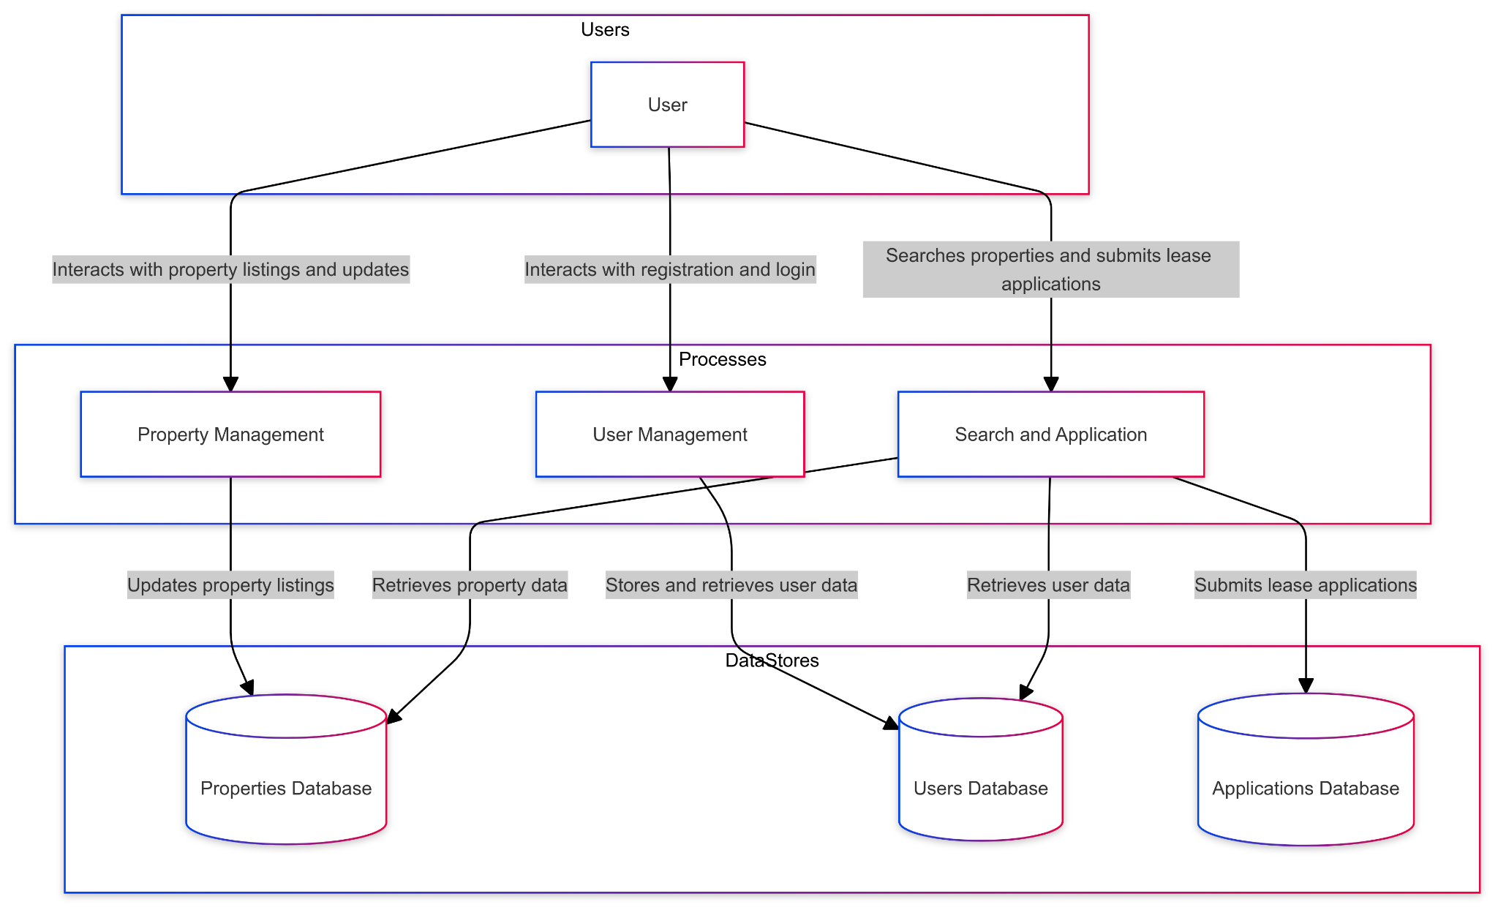
2. Data Flow Diagrams (DFD)

Slide 5
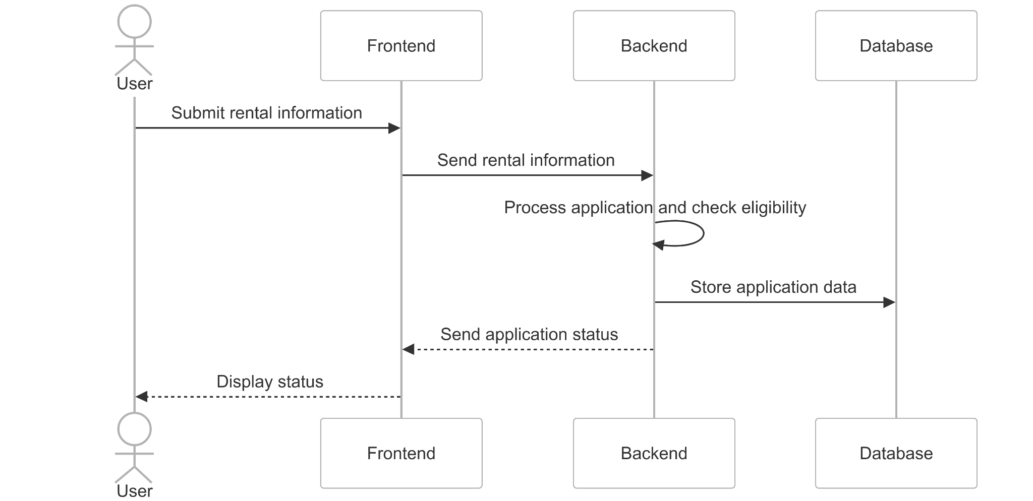
3. Sequence Diagrams

Slide 6
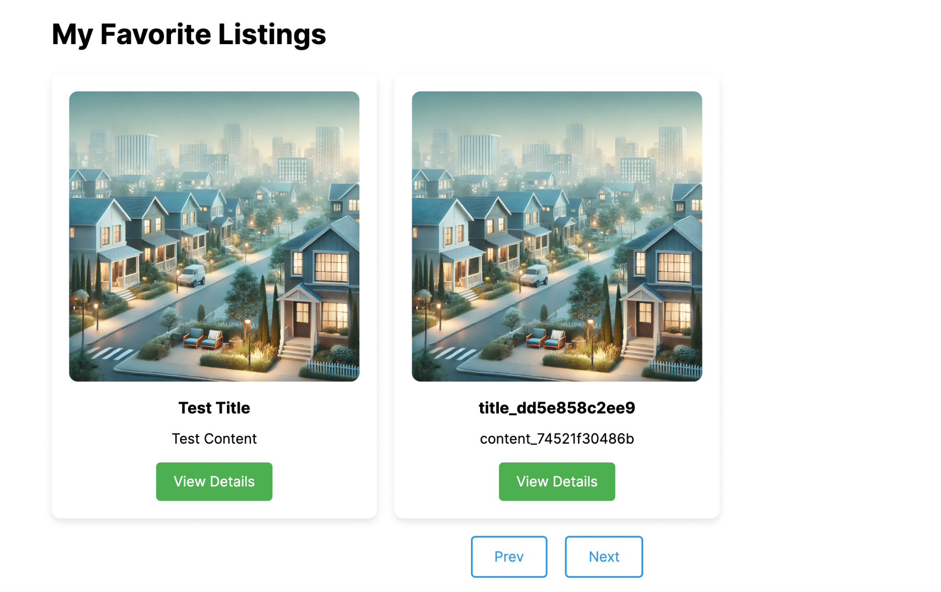
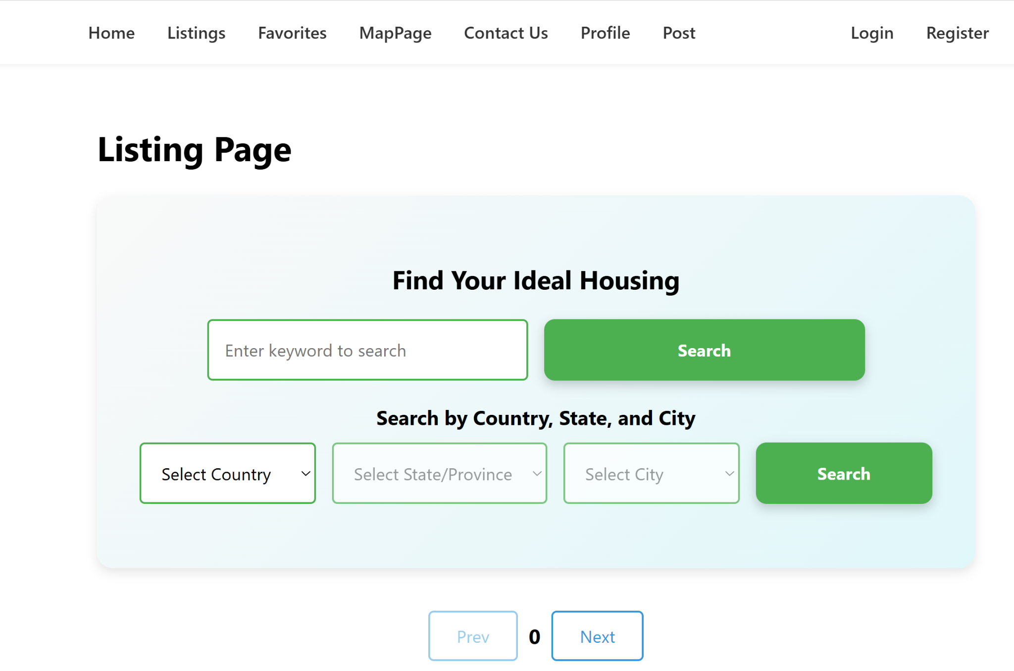
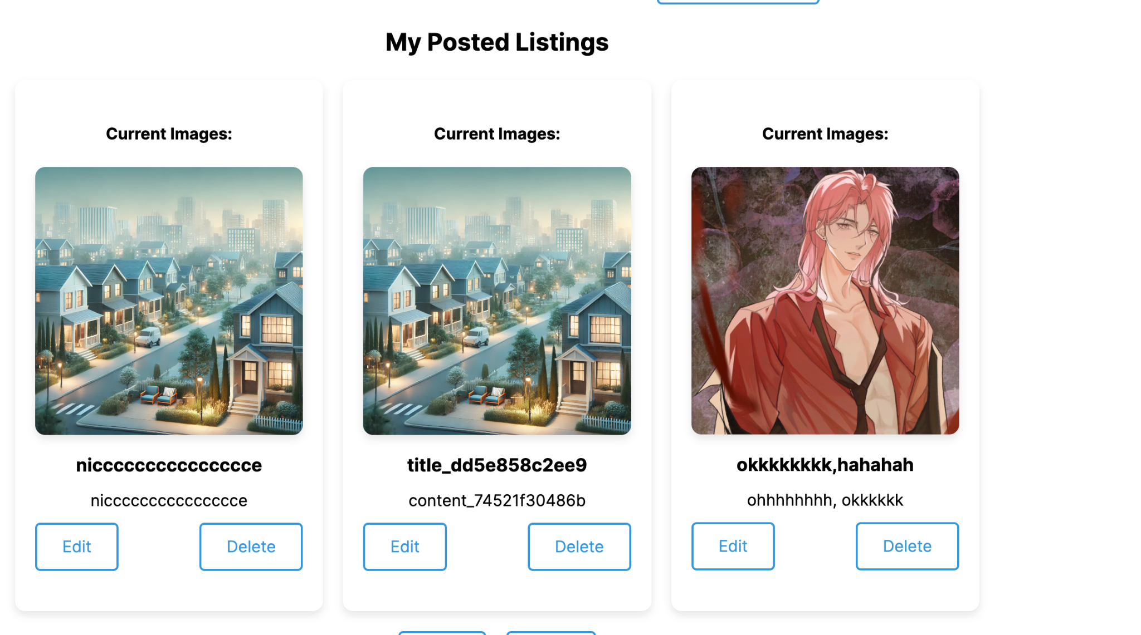
4. New Features Display
RentNinja website(Iteration 1): https://rental-frontend-wa9a.onrender.com

Slide 7
5. QA Testing
The iteration 1 functionalities of coordination between frontend and backend have been done. Initial rounds of QA testing have been completed.
Test Objectives
Verify that all essential functionalities are implemented correctly.
Ensure integration with other services is seamless.
Validate the security features of the platform.
Test Criteria
All test cases must pass without errors.
No critical or high-severity defects should remain unresolved.
Test Scope:
Unit Test (Junit)
UI Test
API Test (Postman)
Integration Test
System Test
Security Test
Initial test code added for qa-backend and qa-frontend, covering core functionalities for both backend and frontend components.

Slide 8
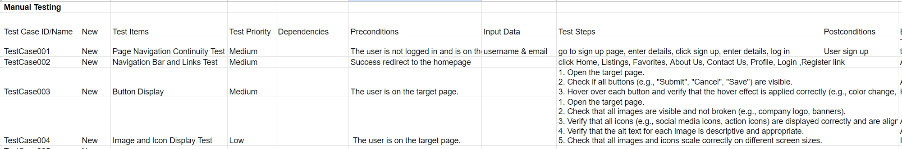
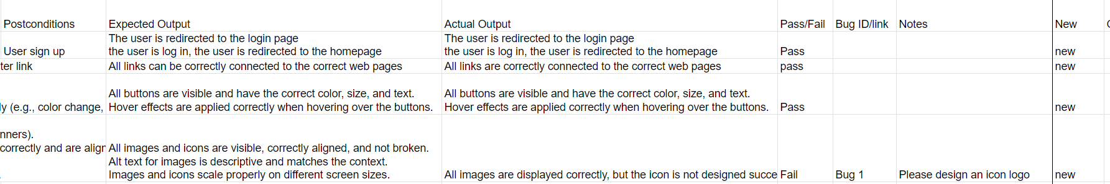
QA Testing Report

Slide 9
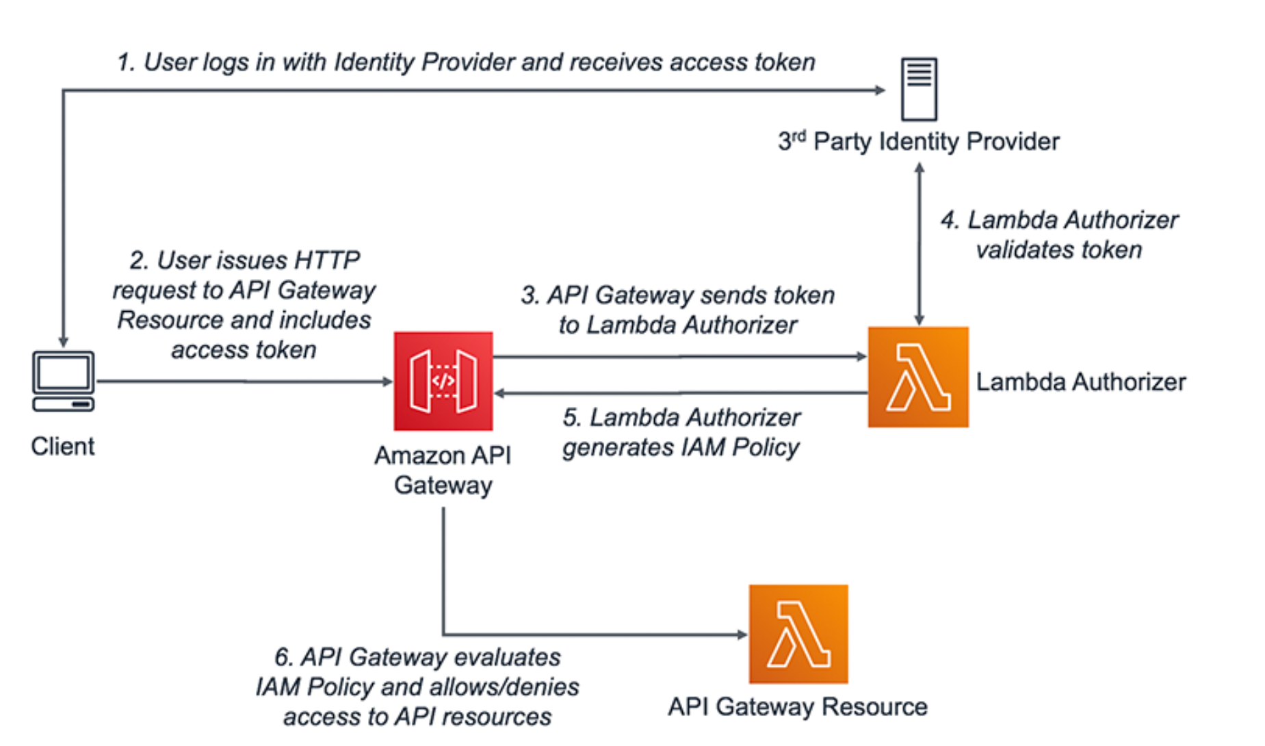
Authorization flow for using tokens in API Gateway

Slide 10
6. Next Steps
All functionalities and requirements will be completed in next final iteration.
Complete all functionalities and ensure they meet the functional requirements.
Conduct thorough QA Testing and Security Testing for all modules.
Address and solve all remaining issues.
Optimize the implementation logic of existing features where possible to ensure efficiency.
Project Deployment needs to be finalized.

Slide 11

THANKS FOR WATCHING

